Slide 1
Predict the Number of Tips Needed to Attain one Point Higher than the Highest Rating in the Area
An individual is looking to open a new coffee shop. They need recommendations for an approximate location to setup their new coffee shop and approximately how many Tips they will need to attain one point higher than the highest rating in their area.

Slide 2
Exploratory Data Analysis
 | Tips_Count | Likes | Rating
count | 27.000000 | 27.000000 | 27.000000
mean | 20.444444 | 65.481481 | 7.029630
std | 29.111633 | 94.191854 | 0.878292
min | 1.000000 | 0.000000 | 5.300000
25% | 5.000000 | 9.000000 | 6.300000
50% | 13.000000 | 34.000000 | 6.900000
75% | 21.000000 | 86.000000 | 7.950000
max | 152.000000 | 449.000000 | 8.400000

Slide 3
Correlation Matrix
We can see that Tips_Count and Likes are highly correlated.
We’ll use Tips_Count in a Simple Linear Regression model since it has a higher correlation (.439460) with Rating in comparison to Likes (.419733).
 | Tips_Count | Likes | Rating
Tips_Count | 1.000000 | 0.945131 | 0.439460
Likes | 0.945131 | 1.000000 | 0.419733
Rating | 0.439460 | 0.419733 | 1.000000

Slide 4
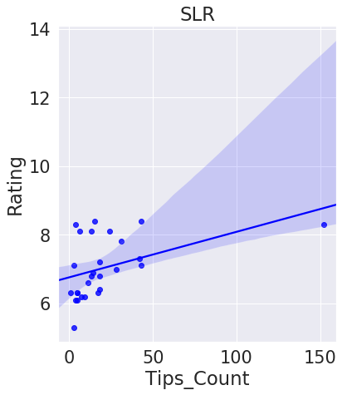
Simple Linear Regression (SLR)
The prediction equation for SLR is .0132584(x) + 6.75856899 and we can see a visual of the prediction line graphed below, relative to the data points used for training the model.

Slide 5
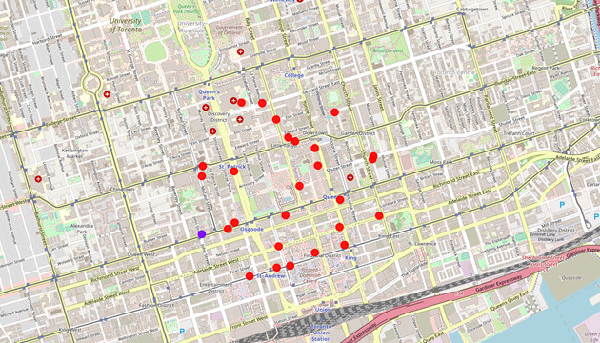
Map of Toronto, Canada with Coffee Shops used in the project.
The purple point represents the location that we recommend building the new coffee shop in the vicinity of. The red points represent the rest of the data points used to train the model to find the number of Tips we’ll need to attain a rating of 9.4.

